Slide 1
GROUP -20
Forever Family Saloon App

Slide 2
Group Members
Sapna Dangar Mansi Chanu Urmila Chakrabarty
20SOECE11010 20SOEIT11005 20SOECE11117
5CE-A 5IT-A 5CE-B

Slide 3
Content
Project titles explored by each group member
Current project definition
Existing system or need for your project
Features
SWOT Analysis
Hardware and Software requirement for development and implementation
Limitations and Future Enhancement

Slide 4
Exploration of Mansi Chanu's Definition
Online
Hospital Appointment
Transportation System
Tourism App
Event Management

Slide 5
Exploration of Urmila Chakrabarty's Definition
Unit Converter Android App
Safe Cab App
Class time table app
E-contact app

Slide 6
Exploration of Sapna Dangar's Definition
All in one govt. Scheme app
Garbage Management App
Self-Care App
Let Go

Slide 7
Concerning our final definition
With the help of this app, our client's business will grow and transition from manual to digital business management methods.
Our app is especially targeted at Forever Saloon, one of our clients.
With this app, we've attempted to meet the fundamental needs of our customer, including:
straightforward direct communication with the saloon
showcasing their best goods and services
displaying unfiltered customer reviews, and more.
Along with the user-friendly interface, our goal is to implement as many features and functionalities as we can.

Slide 8
Features
Login/Logout
Registration
A separate panel that will display the saloon's opening and closing motions.
Users won't need to physically visit the saloon in order to make appointments; they can do so directly from their application.
Customers will be given a section where they can rate and discuss their opinions of the services, overall experience, etc.
All the profitable schemes and offers made by the saloon will be displayed in a separate panel designated for schemes and offers.
Additionally, it will display the fundamental details of the business's owner, employees, and their availability.

Slide 9
Existing system or project-specific requirement
Salon Iris App
My Cuts - Salon Booking App
Yes Madam
My Salon -Salon Booking

Slide 10
SWOT Analysis

Slide 11
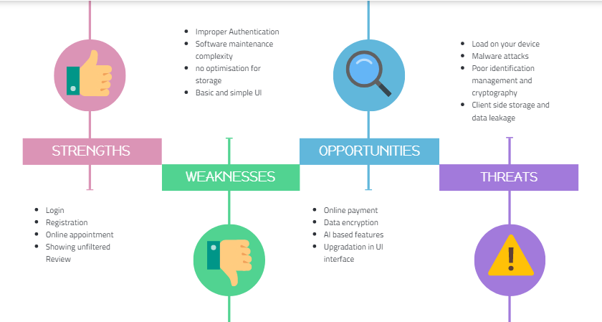

Slide 12
Required Software and Hardware
Hardware
Laptops
Android Mobiles
Software
Android Studio
Backend development
JAVA
Firebase

Slide 13
Limitations
Improper Authentication
Software Maintenance complexity
No optimisation for storage
Basic and simple UI
Future Enhancement
Online payment
Data encryption
Membership Card
Client side storage and data leakage

Slide 14
Time for your Questions!!

Slide 15
Contact Us
Contact
Us
Sapna Dangar
20SOECE11010
dsapna295@rku.ac.in
Mansi Chanu
20SOEIT11005
mchanu735@rku.ac.in
Urmila Chakrabarty
20SOECE11117
uchakrabarty146@rku.ac.in

Slide 16
Thank You!!

